Slide 1
Seeks to cut carbon NOW through systems change.

Slide 2
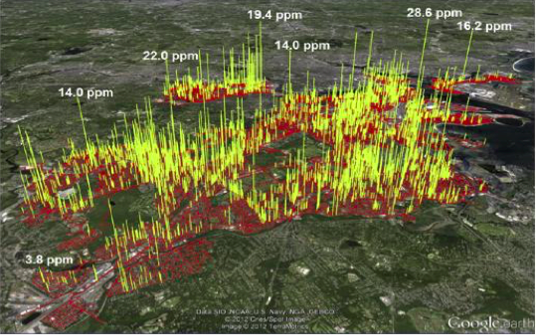
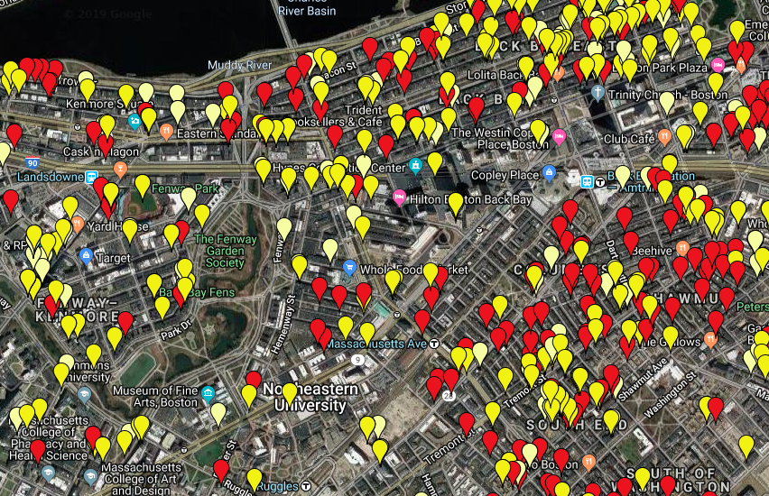
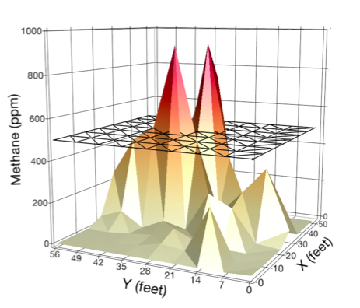
BACKGROUND
2014 > An Act Relative to Natural Gas Leaks
2016 > An Act to Promote Energy Diversity
2018 > An Act to Advance Clean Energy

Slide 3
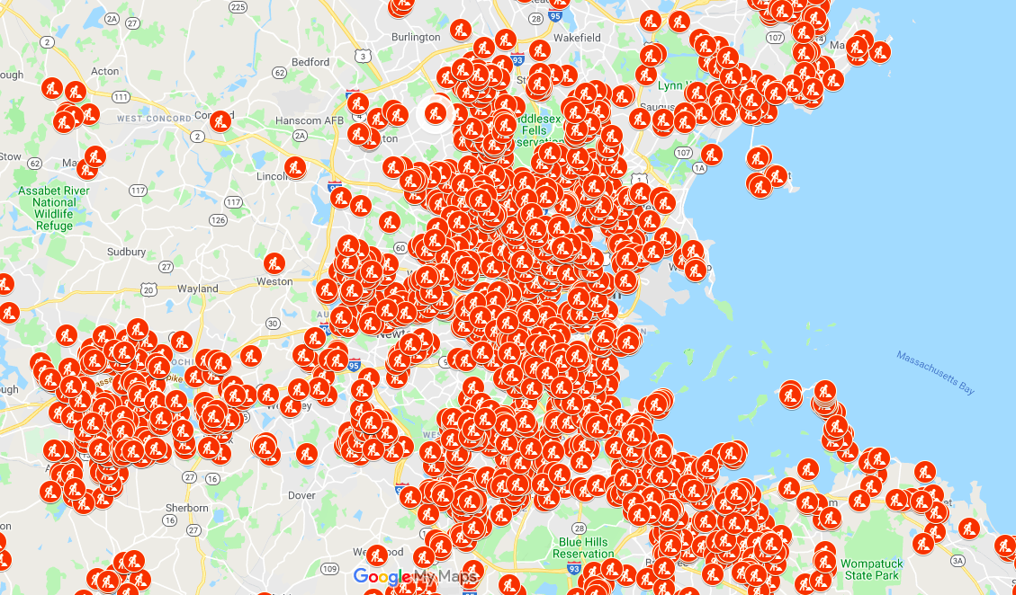
Gas System Enhancement Plan (GSEP)
Utility reported pipe replacement plans for next 5 years
Boston Gas 43% leakprone
Boston $4.4M/mile in 2020
40-year amortization
GWSA and Carbon Free Boston?!

Slide 4
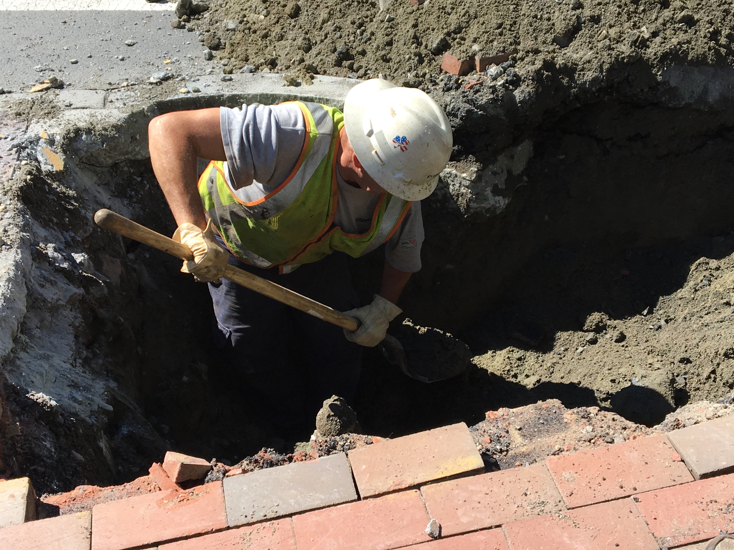
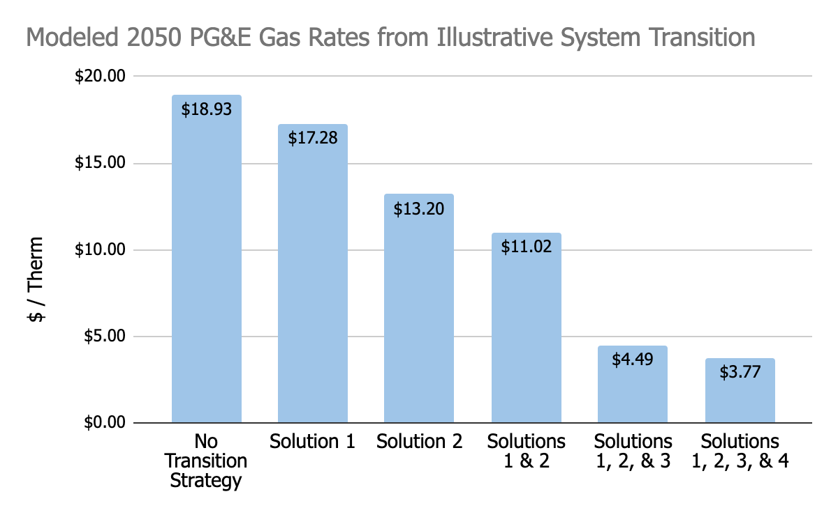
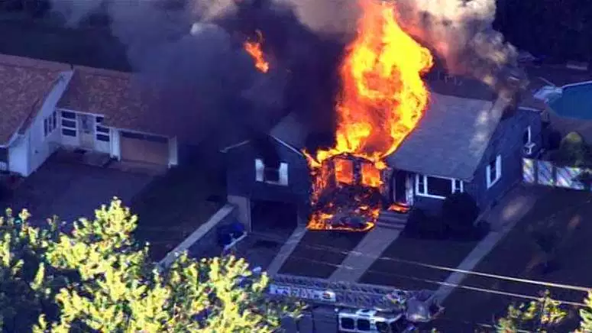
RISKS
GAS BANS
Source: E3, Gridworks 2020

Slide 5
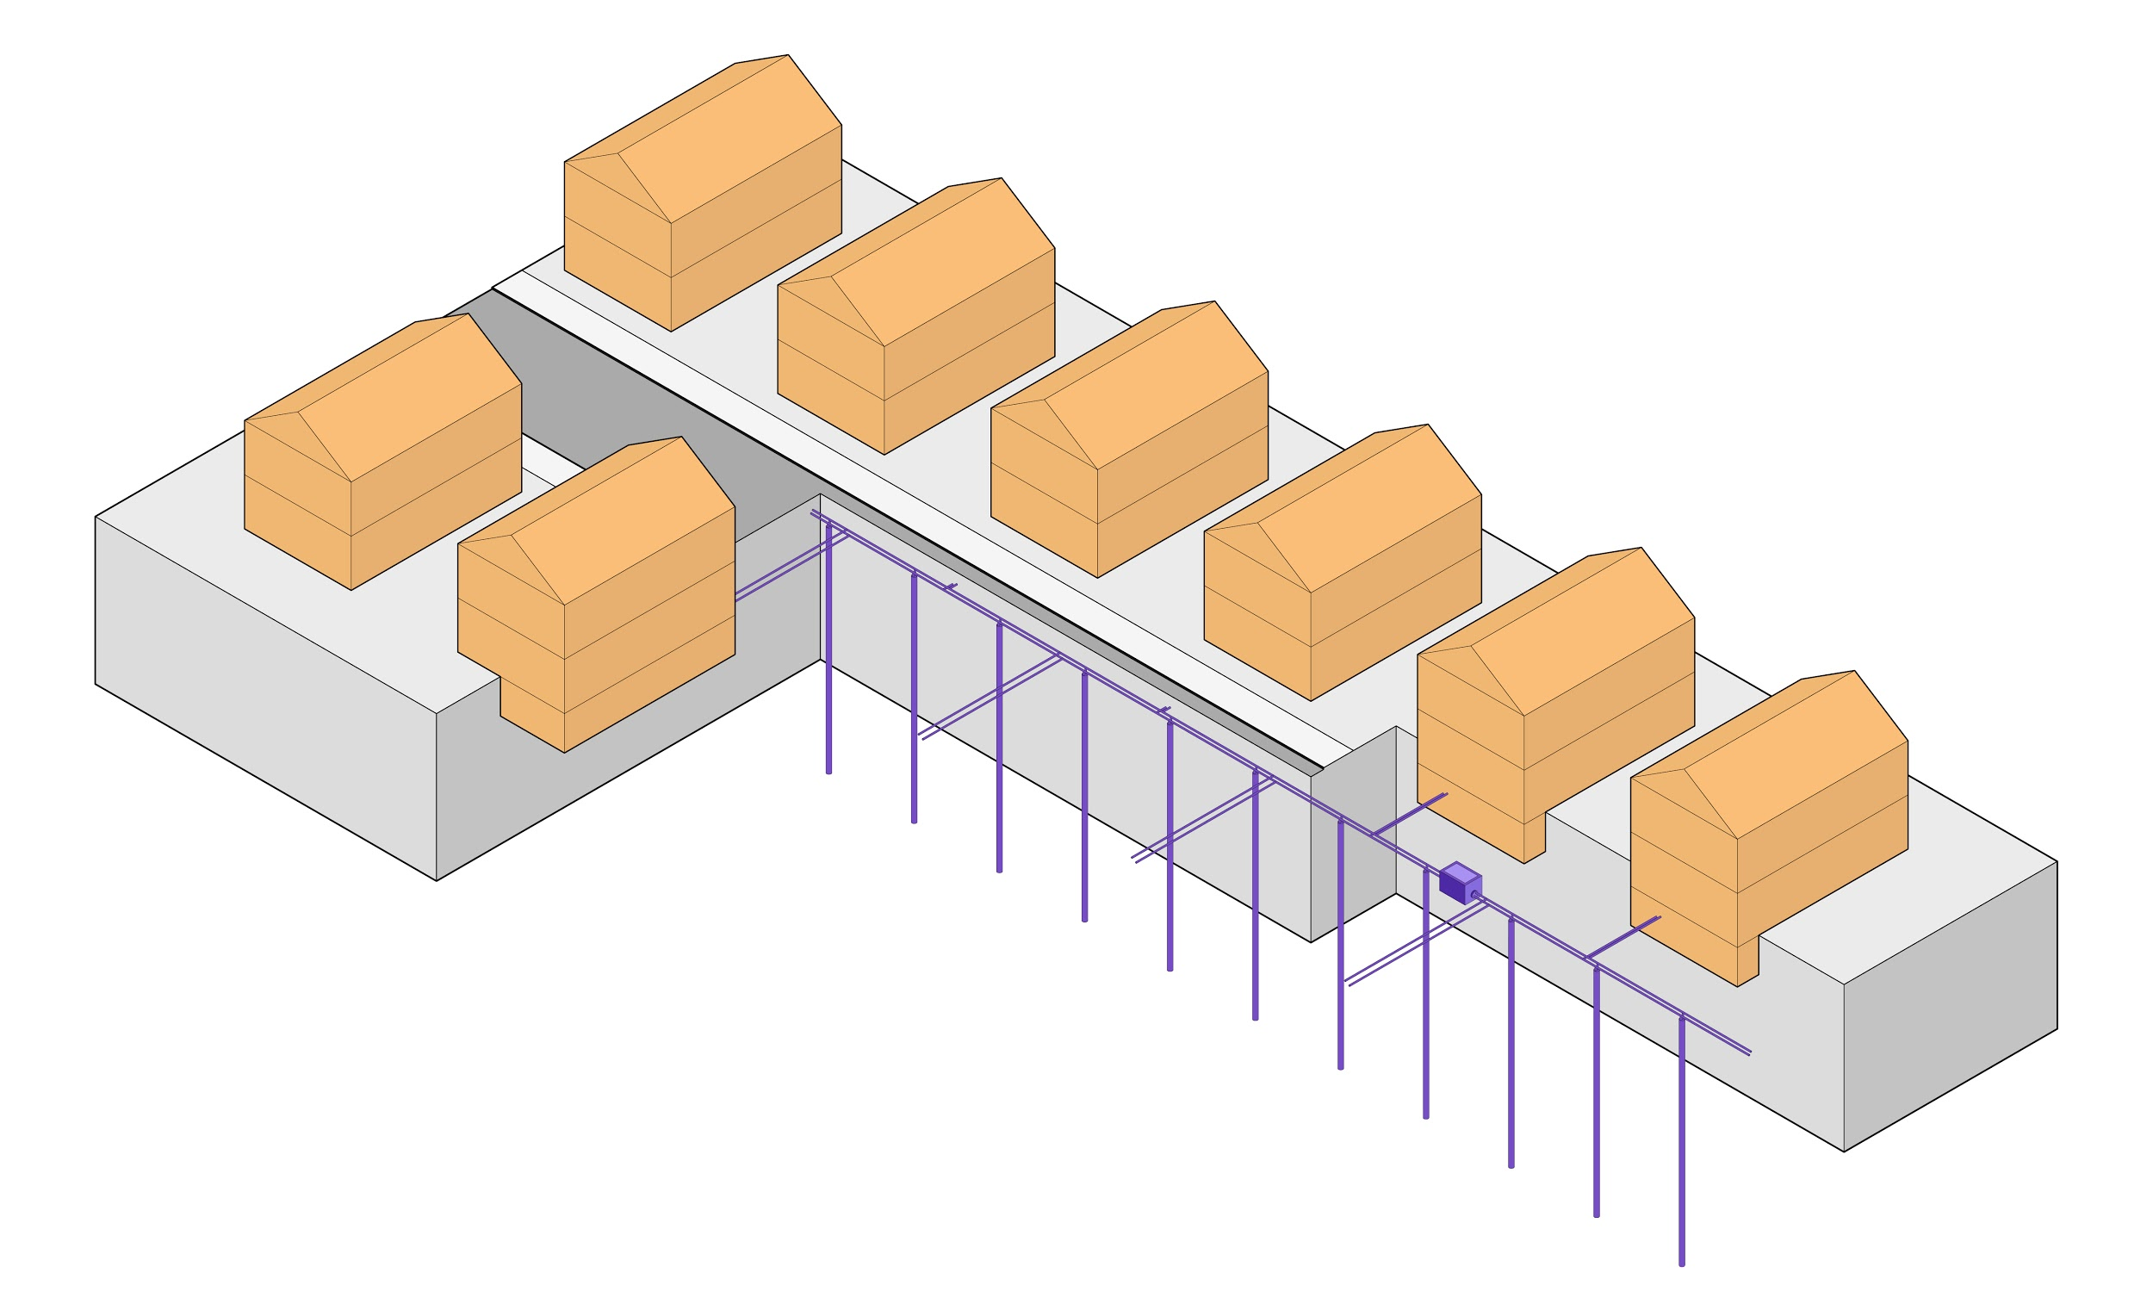
OPPORTUNITY
The GeoMicroDistrict
Notes:
A novel path to building electrification.

Slide 6
The HEET Grid

Slide 7
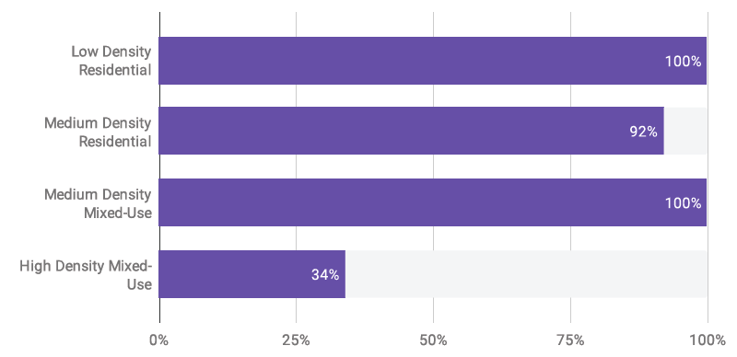
FEASIBILITY (per street segment)
The capacity to meet energy demand through ‘shallow’ boreholes in the street only

Slide 8
INTERCONNECTION
Economies of scale
Load sharing
Load canceling
Thermal storage

Slide 9
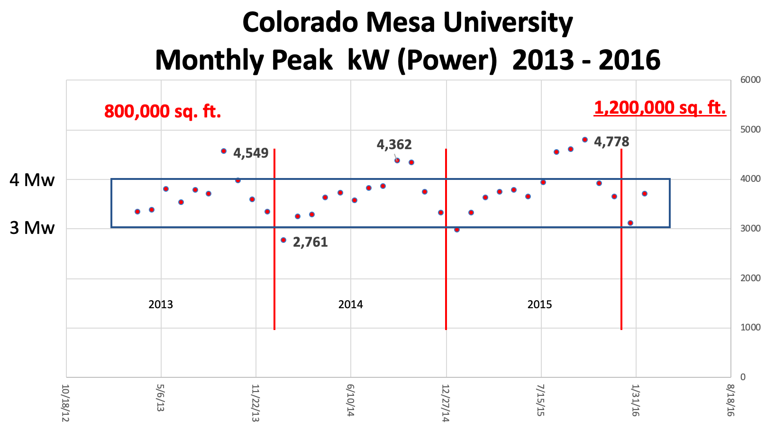
BENEFITS
Colorado Mesa University
PEAK kW Monthly as Shared Geo Grows
2013 (800,000 ft²) – 2016 (1,200,000 ft²)
SAFETY
Cuts GHG 90% by 2050
Equitable access
Keeps gas worker’s jobs
Resilient and reliable
Provides cooling
Flattens grid loads
Cheap energy storage
Courtesy of The GreyEdge Group©

Slide 10
Gas Bans or Gas Plans?
HEET licenses all materials for open sharing
and adapting under Creative Commons CC BY-AS 4.0

